Slide 1

Yamen Şaban
Istanbul Data Science Bootcamp

Slide 2
Project Goal:
The main purpose of this project is to create a model which can help to identify the accidents which had occurred due to a drunk driver.

Slide 3
About the Project:
Start with finding a better data source than Kaggle.
Getting the EC2 instance ready.
Load data into PostgreSQL and create joined views.
Explore the data by applying Exploratory Data Analysis(EDA).
Try imbalenced label sampling methods.
Voting approach.
Final Results.

Slide 4

Finding Better Data source:
If I were only to depend on Kaggle’s dataset I would have been left with some old data that goes back to (2015).
After doing some research I was able to find the real source of data NHTSA and got more recent data (2018).
And because the data by itself is not enough I had to look to find its documentation on the same site BAAM(done).

Slide 5

Getting EC2 instance Ready:
Opening an Amazon Web Services(AWS) account.
Create an EC2 instance type t2.micro(free).
I have written a blog about configuring the EC2 to run PostgreSQL, Anaconda, Jupyter Notebook on Medium.
I will be to storing my data on the EBS volume connected to the instance and run my Python code from the local device on the instance throw tunneling.

Slide 6
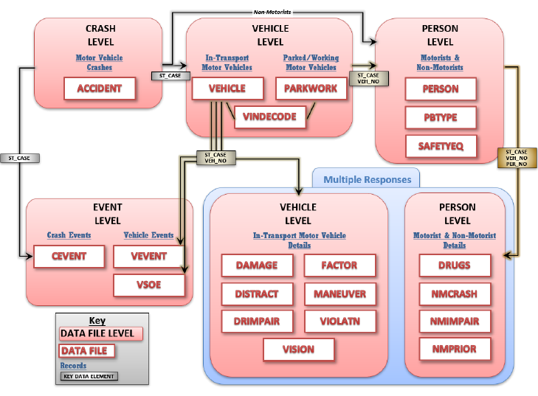
Load Data into PostgreSQL:
After a general overview of the data and depending on the diagram on the right I decided to choose 3 tables of the 27 available once (Accident, Vehicle, Person).
(Accident Vehicle Person) for join.
Thanks to the data documentation I was able to determine which features to use easily (will be explained in the next slides).

Slide 7
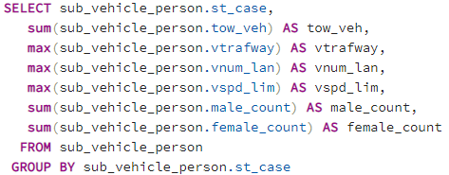
Create Joined Views:
Because there are (One to Many) relations between the tables I needed to find a way to aggregate features into one line to fit it into the model.
I had to remove the features not aggregatable.
No features from the Person table were aggregatable, but I calculated the count of males an females in each car.
From the Vehicle table I’ve decided to take the features shown in the picture with suitable aggregation methods.
Finally create joined views.

Slide 8
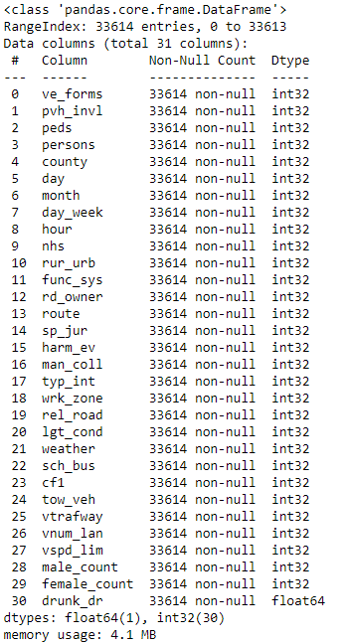
Used Columns:

Slide 9
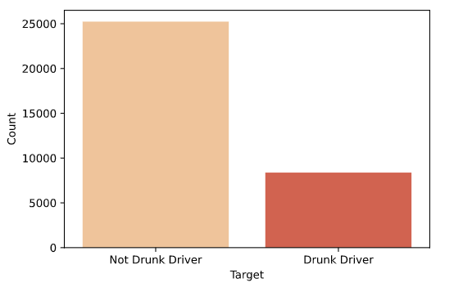
Exploratory Data Analysis(EDA):
Exploring the Target Variable:
After taking a look into the target variable I have found the it contains values(0,1,2,3,4) which represents the number of drunk people involved so in case I wanted to use this column as the target variable I have to map values larger then one to one(Imbalanced HaH!).

Slide 10
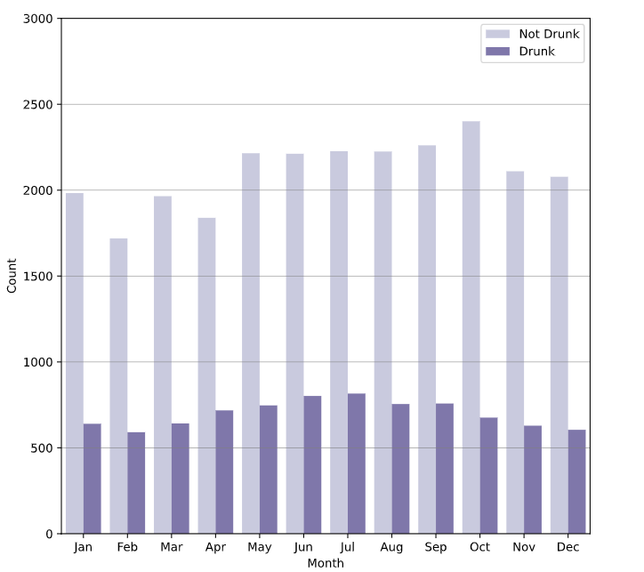
Exploring the Accidents in Terms of Months:
Number of accidents accrued due to drinking events is rising towards the summer which can be much reasonable(Party All Night).

Slide 11
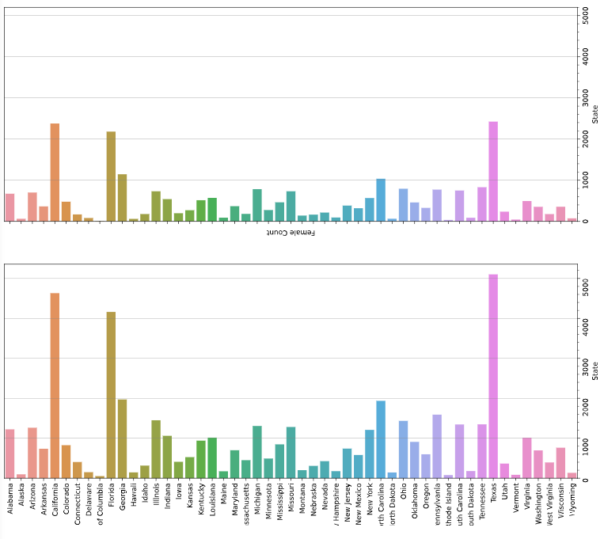
Exploring the Accidents in Terms of States Male/Female Counts:

Slide 12
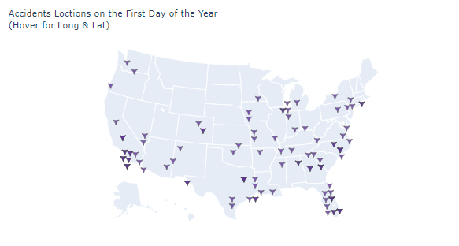
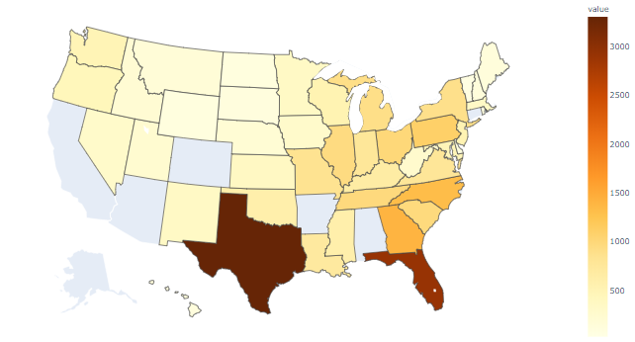
Geo Maps for Better Demonstration:

Slide 13
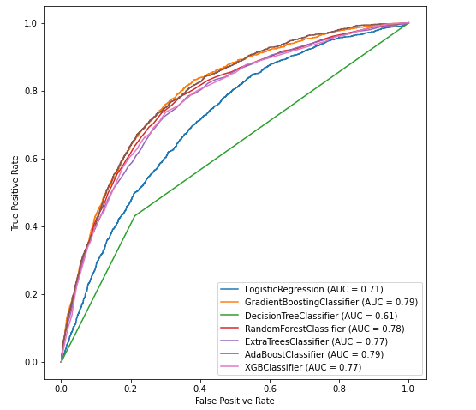
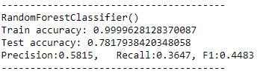
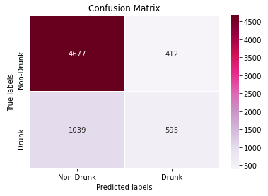
Imbalenced label sampling methods:
Training Without Changing:
First I tried to look for the best model which can give me the best results without using any class imbalance methods. Random Forest Classifier was the winner.
After Cross-Validation I got accuracy: 0.78

Slide 14


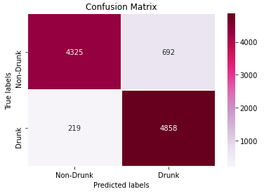
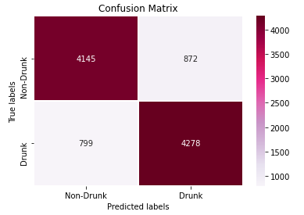
Training With Random Over Sampler:
Training With SMOTE:
After Cross-Validation I got accuracy: 0.90
After Cross-Validation I got accuracy: 0.81

Slide 15


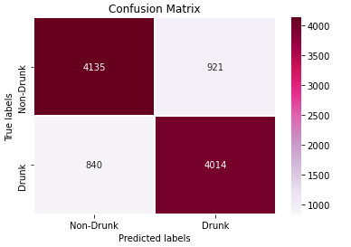
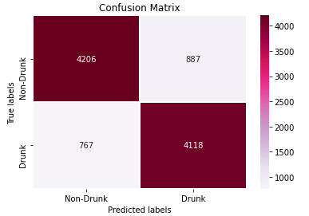
Training With ADASYN:
Training With SMOTETOMEK:
After Cross-Validation I got accuracy: 0.79
After Cross-Validation I got accuracy: 0.81

Slide 16

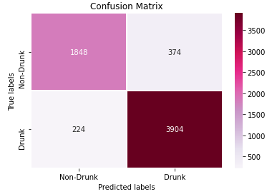
Training With SMOTEENN:
After Cross-Validation I got accuracy: 0.87

Slide 17
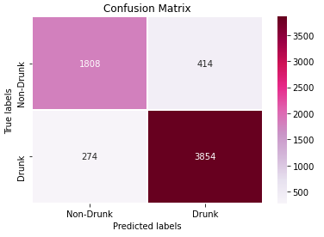

Voting approach:
Training Using Voting:
I used 5 of the most succeeded models from before:
Random Forest Classifier
GradientBoostingClassifier
AdaBoostClassifier
XGBClassifier
ExtraTreesClassifier
With weights=[5,4,3,2,1]

Slide 18
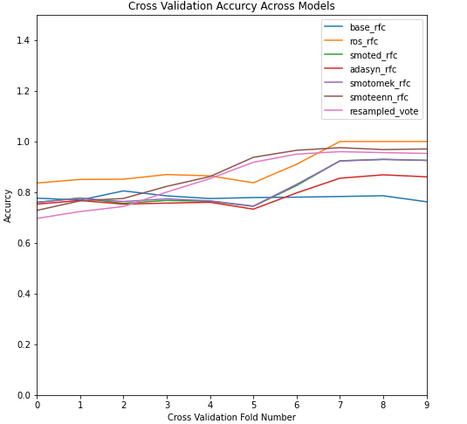
Final Results:

Slide 19
Thank You
LinkedIN:
Medium:
Github:
https://www.linkedin.com/in/yamenshaban/
Medium: https://medium.com/@yamenshabankabakibo
https://github.com/yamenkaba

